Slide 1
Slides for Chapter 5
Note to Instructors
This Keynote document contains the slides for “Divide and Conquer”, Chapter 5 of Explorations in Computing: An Introduction to Computer Science and Python Programming.
The book invites students to explore ideas in computer science through interactive tutorials where they type expressions in Python and immediately see the results, either in a terminal window or a 2D graphics window.
Instructors are strongly encouraged to have a Python session running concurrently with Keynote in order to give live demonstrations of the Python code shown on the slides.
License
The slides in this Keynote document are based on copyrighted material from Explorations in Computing: An Introduction to Computer Science and Python Programming, by John S. Conery.
These slides are provided free of charge to instructors who are using the textbook for their courses.
Instructors may alter the slides for use in their own courses, including but not limited to: adding new slides, altering the wording or images found on these slides, or deleting slides.
Instructors may distribute printed copies of the slides, either in hard copy or as electronic copies in PDF form, provided the copyright notice below is reproduced on the first slide.
© 2015 John S. Conery

Slide 2
Divide and Conquer
Breaking large problems into smaller subproblems
Binary Search
Binary Search Experiments
Merge Sort
Merge Sort Experiments
Recursive Methods

Slide 3
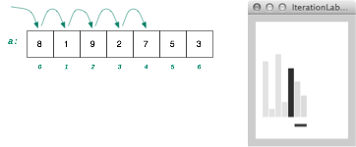
Iterative Searches
The previous slides on iterative algorithms introduced search algorithms that did a “linear scan” through a list
to find an item call isearch(a,x)
a is the list, x is the item to look for
start at the front of a, scan right until x found
return value is location of x or None
Example:
>>> a = RandomList(5,'fish')
>>> a ['trout', 'marlin', 'flounder', 'albacore', 'steelhead']
>>> isearch(a, 'flounder') 2

Slide 4
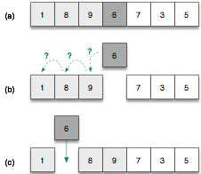
Simple Sorts
We also saw how to sort a list using a similar strategy
Scan the list from left to right, and for each item x:
remove x from the list
scan left to find a place for x
re-insert x into the list
This “insertion sort” algorithm has nested loops
outer loop is a linear progression left to right
inner loop scans back to find a place for x
The number of comparisons made when sorting a list of n items is as high as

Slide 5

Divide and Conquer
The strategy for both algorithms: iterate over every location in the list
A new strategy is introduced in this chapter: divide and conquer
break a problem into smaller pieces and solve the smaller sub-problems
It may not seem like that big a deal, but the improvement can be dramatic
approximate number of comparisons (worst case) for a list of n items:
search
 | n = 100 | n = 1,000
search | 100 | 1000
bsearch | 7 | 10
sort
 | n = 100 | n = 1,000
isort | 5,000 | 500,000
msort | 700 | 10,000

Slide 6
Searching a Dictionary
To get a general sense of how the divide and conquer strategy improves search, consider how people find information in a phone book or dictionary
suppose you want to find “janissary” in a dictionary
open the book near the middle
the heading on the top left page is “kiwi”, so move back a small number of pages
here you find “hypotenuse”, so move forward
find “ichthyology”, move forward again
The number of pages you move gets smaller (or at least adjusts in response to the words you find)

Slide 7
Searching a Dictionary
A detailed specification of this process:
the goal is to search for a word w in region of the book
the initial region is the entire book
at each step pick a word x in the middle of the current region
there are now two smaller regions: the part before x and the part after x
if w comes before x, repeat the search on the region before x, otherwise search the region following x (go back to step 3)
Note: at first a “region” is of a group of pages, but eventually a region is a set of words on a single page

Slide 8
A Note About Organization
An important note: an efficient search depends on having the data organized in some fashion
if books in a library are scattered all over the place we have to do an iterative search
start at one end of the room and progress toward the other
If books are sorted or carefully cataloged we can try a binary search or other method
http://www.endlessbookshelf.net/shelves.html
Knight Library at the University of Oregon

Slide 9
Binary Search
The binary search algorithm uses the divide-and-conquer strategy to search through a list
The list must be sorted
the “zeroing in” strategy for looking up a word in the dictionary won’t work it the words are not in alphabetical order
similarly, binary search will not work unless the input list is sorted

Slide 10
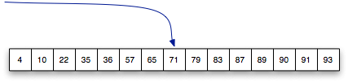


Binary Search
To search a list of n items, first look at the item in location n/2
then search either the region from 0 to n/2-1 or the region from n/2+1 to n-1
Example: searching for 57 in a sorted list of 15 numbers
start in the middle
③
②
①

Slide 11

Detailed Description
The algorithm uses two variables to keep track of the boundaries of the region to search
lower the index one below the leftmost item in the region
upper the index one above the rightmost region
[
]
initial values when searching a list of n items:
lower = -1
upper = n

Slide 12
Detailed Description
The algorithm is based on an iteration (“loop”) that keeps making the region smaller and smaller
the initial region is the complete list
the next one is either the upper half or lower half
the one after that is one quarter, then one eighth, then...
[
]
initial values when searching a list of n items:
lower = -1
upper = n

Slide 13
Detailed Description
The heart of the algorithm contains these operations:
set mid to a location half way between lower and upper:
mid = (lower + upper) // 2
if the item is at this location we’re done:
if a[mid] == x: return mid
otherwise move one of the “brackets” to the current mid point for the next iteration:
if x < mid: upper = mid else: lower = mid
note the use of // instead of /
Examples on the next slide

Slide 14

Example
This example shows the steps while searching for 46 in a list of 15 numbers
The first iteration:
lower = -1
upper = 15
mid = 14 / 2 = 7
upper for next iteration: 7

Slide 15


Example
The remaining iterations when searching for 46:
lower = -1 upper = 7 mid = 3 lower = 3
lower = 3 upper = 7 mid = 5 found it!
This search required only 3 comparisons:
a[7], a[3], a[5]

Slide 16
Unsuccessful Searches
What happens in this algorithm if the item we’re looking for is not in the list?
Example: search for 58
lower = 3 upper = 7 mid = 5 lower = 5
lower = 5 upper = 7 mid = 6 upper = 6
lower = 5 upper = 6 mid = 5 lower = 5
[
*
]
[
*
]
[
]
uh-oh... lower didn’t change — we’re in an infinite loop!!

Slide 17
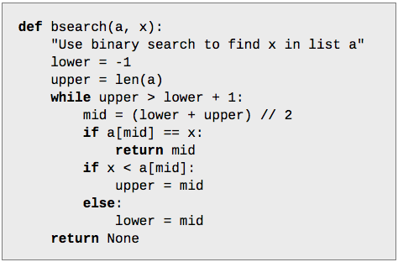
Unsuccessful Searches
To avoid an infinite loop make sure the iteration stops when the region to search shrinks down to 0 items
this happens when upper equals lower + 1
recall lower and upper are locations outside the region

Slide 18
Examples with bsearch
The bsearch method is part of a module named RecursionLab
>>> from PythonLabs.RecursionLab import *
>>> a = RandomList(15, sorted=True)
>>> a [11, 15, 19, 26, 32, 35, 38, 66, 68, 70, 76, 77, 81, 83, 94]
>>> bsearch(a, 19) 2
>>> bsearch(a, 33)
>>>
Make sure the list is sorted!

Slide 19
Experiments with bsearch
If you add a call to a helper function named print_bsearch_brackets you can see how lower and upper change as the search progresses

Slide 20
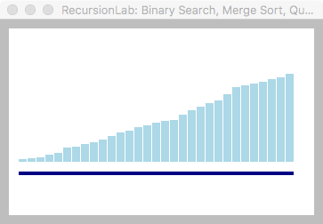
Visualization
Call view_list to display a list as a set of vertical bars
The current region (the part of the list between lower and upper) is indicated by a dark horizontal line below the list

Slide 21
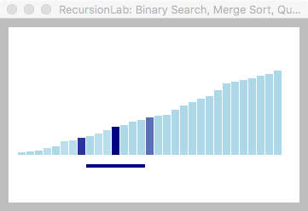
Visualization
During the search the display will be updated
when the midpoint is selected the corresponding bar is darkened
that bar will become the upper or lower edge of the new search region

Slide 22
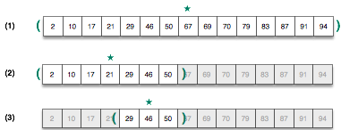
Cutting the Problem Down to Size
It should be clear why we say the binary search uses a divide and conquer strategy
the problem is to find an item within a given range
at each step the problem is split into two equal sub-problems
focus turns to one sub-problem for the next step

Slide 23
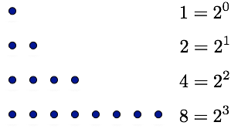
Number of Comparisons
The number of iterations made by this algorithm when it searches a list containing n items is roughly
To see why, consider the question from the other direction
let’s start with a list containing 1 item
suppose each step of an iteration doubles the size of the list
after n steps we will have 2^{n} items in the list

Slide 24
Number of Comparisons
By definition, if then
list size = n
#steps = log2 n

Slide 25
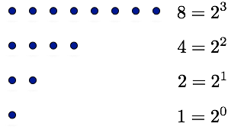

Number of Comparisons
When we’re searching we’re reducing an area of size n down to an area of size 1
e.g. n = 8 in this diagram
A successful search might return after the first comparison
An unsuccessful search does all iterations

Slide 26
Searching Long Lists
Divide and conquer may seem like a lot of extra work for such a simple process
For large lists, however, that work leads to a very efficient search
we’ll need at most 30 comparisons to find something in a list of 1 billion items

Slide 27
Divide and Conquer Sorting Algorithms
The divide and conquer strategy used to make a more efficient search algorithm can also be applied to sorting
Two well-known sorting algorithms:
QuickSort
divide a list into big values and small values, then sort each part
Merge Sort
sort subgroups of size 2, merge them into sorted groups of size 4, merge those into sorted groups of size 8, ...
The remaining slides will have an overview of merge sort and look at how it can be implemented in Python
see the textbook for more information about quicksort

Slide 28
Merge Sort
The merge sort algorithm works from “the bottom up”
start by solving the smallest pieces of the main problem
keep combining their results into larger solutions
eventually the original problem will be solved
Example: sorting playing cards
divide the cards into groups of two
sort each group -- put the smaller of the two on the top
merge groups of two into groups of four
merge groups of four into groups of eight
...
examples on next slide

Slide 29
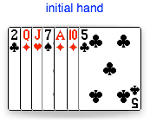
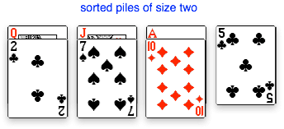
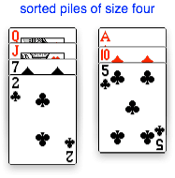
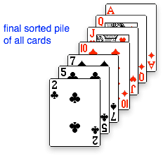
Merge Sort (cont’d)
Example with a hand of seven cards

Slide 30
Merge Sort
What makes this method more effective than simple insertion sort?
merging two piles is a very simple operation
only need to look at the two cards currently on the top of each pile
no need to look deeper into either group
In this example:
compare 2 with 5, pick up the 2
compare 5 with 7, pick up the 5
compare 7 with 10, pick up the 7
....

Slide 31





Merge Sort
Another example, using a list of numbers
sorted blocks are indicated by adjacent cells with the same color

Slide 32
msort Demo
The merge sort algorithm has been implemented in PythonLabs as a function named msort
>>> from PythonLabs.RecursionLab import *
To watch a sort in action, create a random list of integers, display it on the canvas, and call msort:
>>> a = RandomList(32)
>>> view_list(a)
>>> msort(a)
Note this is the same technique used to visualize isort

Slide 33
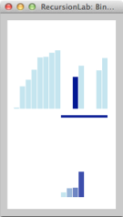
msort Demo
The list to sort is drawn at the top of the canvas
The horizontal bar is displayed below two groups of numbers
When a value is merged it is highlighted and moved to the end of the merge area at the bottom of the canvas

Slide 34
msort Demo
It’s also possible to monitor the progress of a sort by inserting a call to a helper function
add a call to print_msort_brackets to the top level loop
brackets will be printed around each group
on the first iteration you’ll see groups of 1, then groups of 2, etc
>>> a = [8, 5, 1, 7, 9, 2, 6, 3]
>>> msort(a) [8] [5] [1] [7] [9] [2] [6] [3] [5 8] [1 7] [2 9] [3 6] [1 5 7 8] [2 3 6 9]
Note values in each group are in order: they were sorted on the previous iteration

Slide 35
Implementing Merge Sort
The code shown in the textbook uses a helper function named merge_groups
simply pass the helper a group size
it will find adjacent groups in a list and merge them
the main loop doubles the group size until the list is just one large group
uncomment the call to print_msort_brackets to monitor the progress of the sort

Slide 36
Implementing Merge Sort (cont’d)
The merge_groups function uses a function from Python’s library
call merge(x,y) to merge two lists x and y
the call on line 16 calls merge with two slices from a, the list we’re sorting
The key to understanding this function is to see how index variables named i, j, and k define the boundaries of two adjacent blocks in a
i is the left edge of the first block
j is the left edge of the second block (and thus just to the right of the end of the first block)
k is one location past the right edge of the second block
The assignment on line 16 replaces the two adjacent input blocks with the merged values

Slide 37
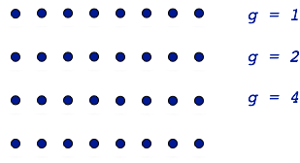
Comparisons in Merge Sort
To completely sort a list with n items requires log2 n iterations
the group size starts at 1 and doubles on each iteration
During each iteration there are at most n comparisons
comparisons occur in the merge method
compare values at the front of each group
may have to work all the way to the end of each group, but might stop early (e.g. with cards one pile is emptied but more than one left in the other pile)
Total comparisons ≈

Slide 38
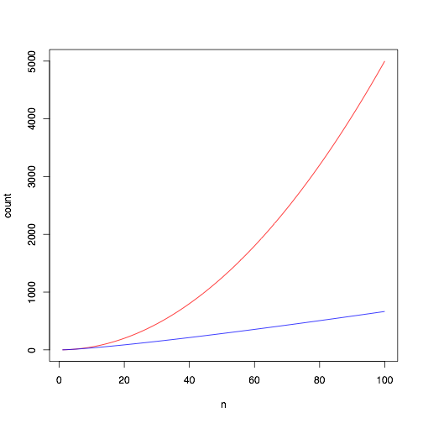
Scalability of Merge Sort
Is this new formula that much better than the comparisons made by isort?
not that big of a difference for small lists
but as the length of the list increases the savings start to add up

Slide 39
Scalability of Merge Sort (cont’d)

Slide 40
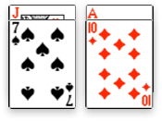


Sort Algorithms in Real Life
These algorithms can be used in the real world
it might be fun to try merge sort on a deck of cards
Merge sort can be done in a very small space
pick up the smaller of the two top cards
lay it face down in a new pile
when merging the next two groups the new pile should be at right angles so you know where the group starts
turn the deck over and repeat

Slide 41
Recap: Divide and Conquer Algorithms
The divide and conquer strategy often reduces the number of iterations of the main loop from n to log2 n
binary search:
merge sort:
It may not look like much, but the reduction in the number of iterations is significant for larger problems

Slide 42
Summary
These slides introduced the divide and conquer strategy
for searching: binary search
requires list to be sorted
for sorting: merge sort
Binary search will find an item using at most comparisons
Mergesort does at most comparisons
An algorithm that uses divide and conquer can be written using iteration or recursion
recursive = “self-similar”
a problem that can be divided into smaller subproblems of the same type
a recursive method calls itself
See the text for examples of how Python functions can call themselves…

